Slide 1
Gu Wee Oh! Card Fight Team #4 Oliver Arce, Daniel Freeman, Pranab Pudasaini, Marissa Scroggins
This project simulates a game where the players are given elemental cards, and may play two of them to damage opponents, with some card combinations changing the damage dealt.

Slide 2
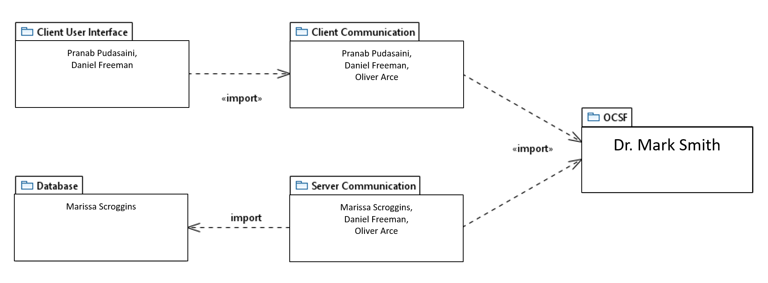
Package Diagram

Slide 3
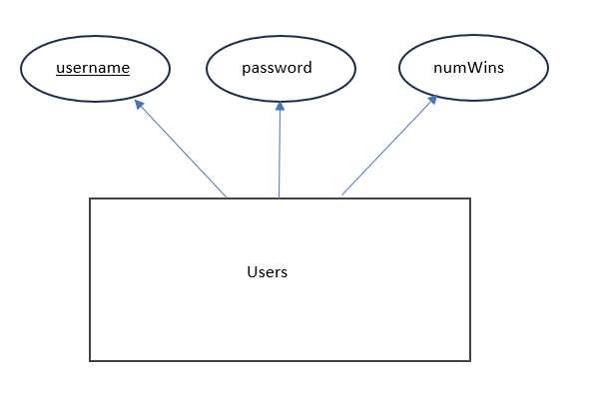
Database Design Diagram

Slide 4
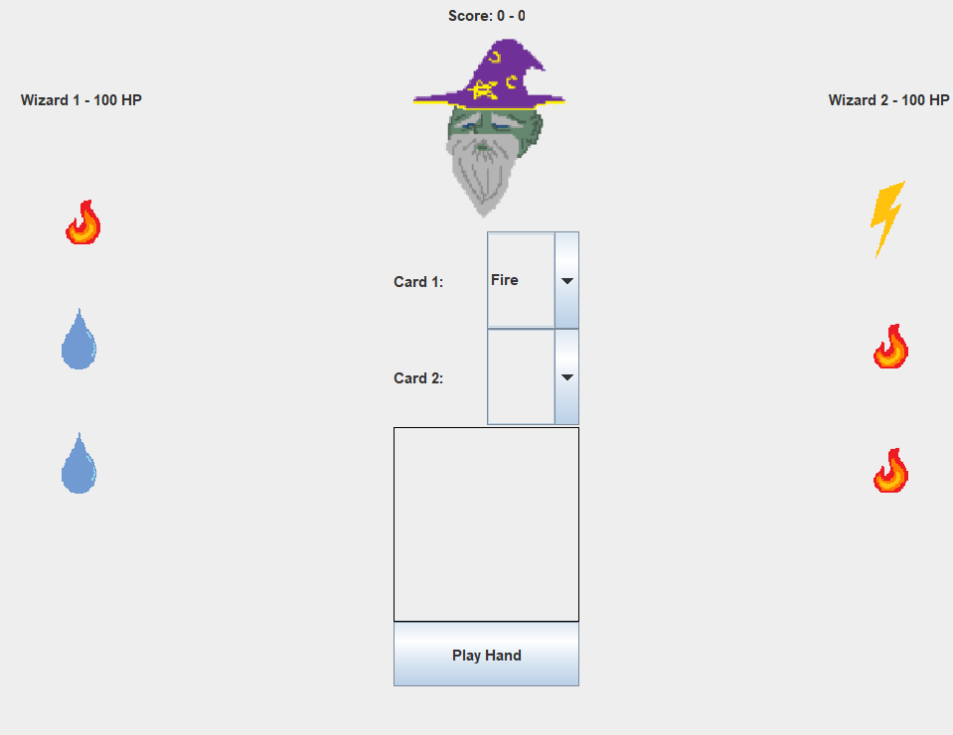
Functional Requirements
Once a player selects their cards and clicks play hand, the system will calculate the damage a combination will produce based on the Damage Points listed on each card, as well as potential Damage Multipliers as calculated by the cards’ properties (DetermineDamage).

Slide 5
Use Case Description

Slide 6
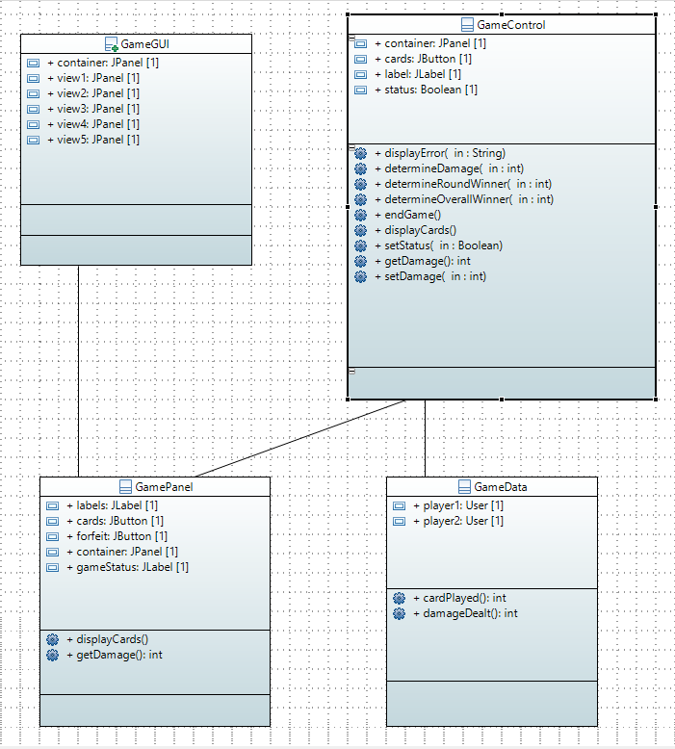
Initial Class Diagram

Slide 7
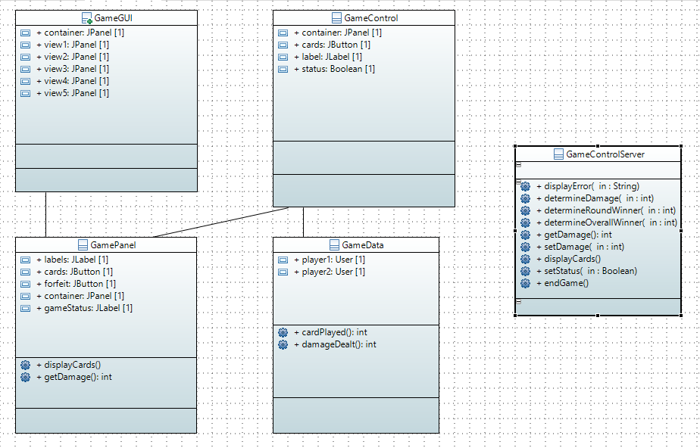
Final Class Diagram

